Slide 1
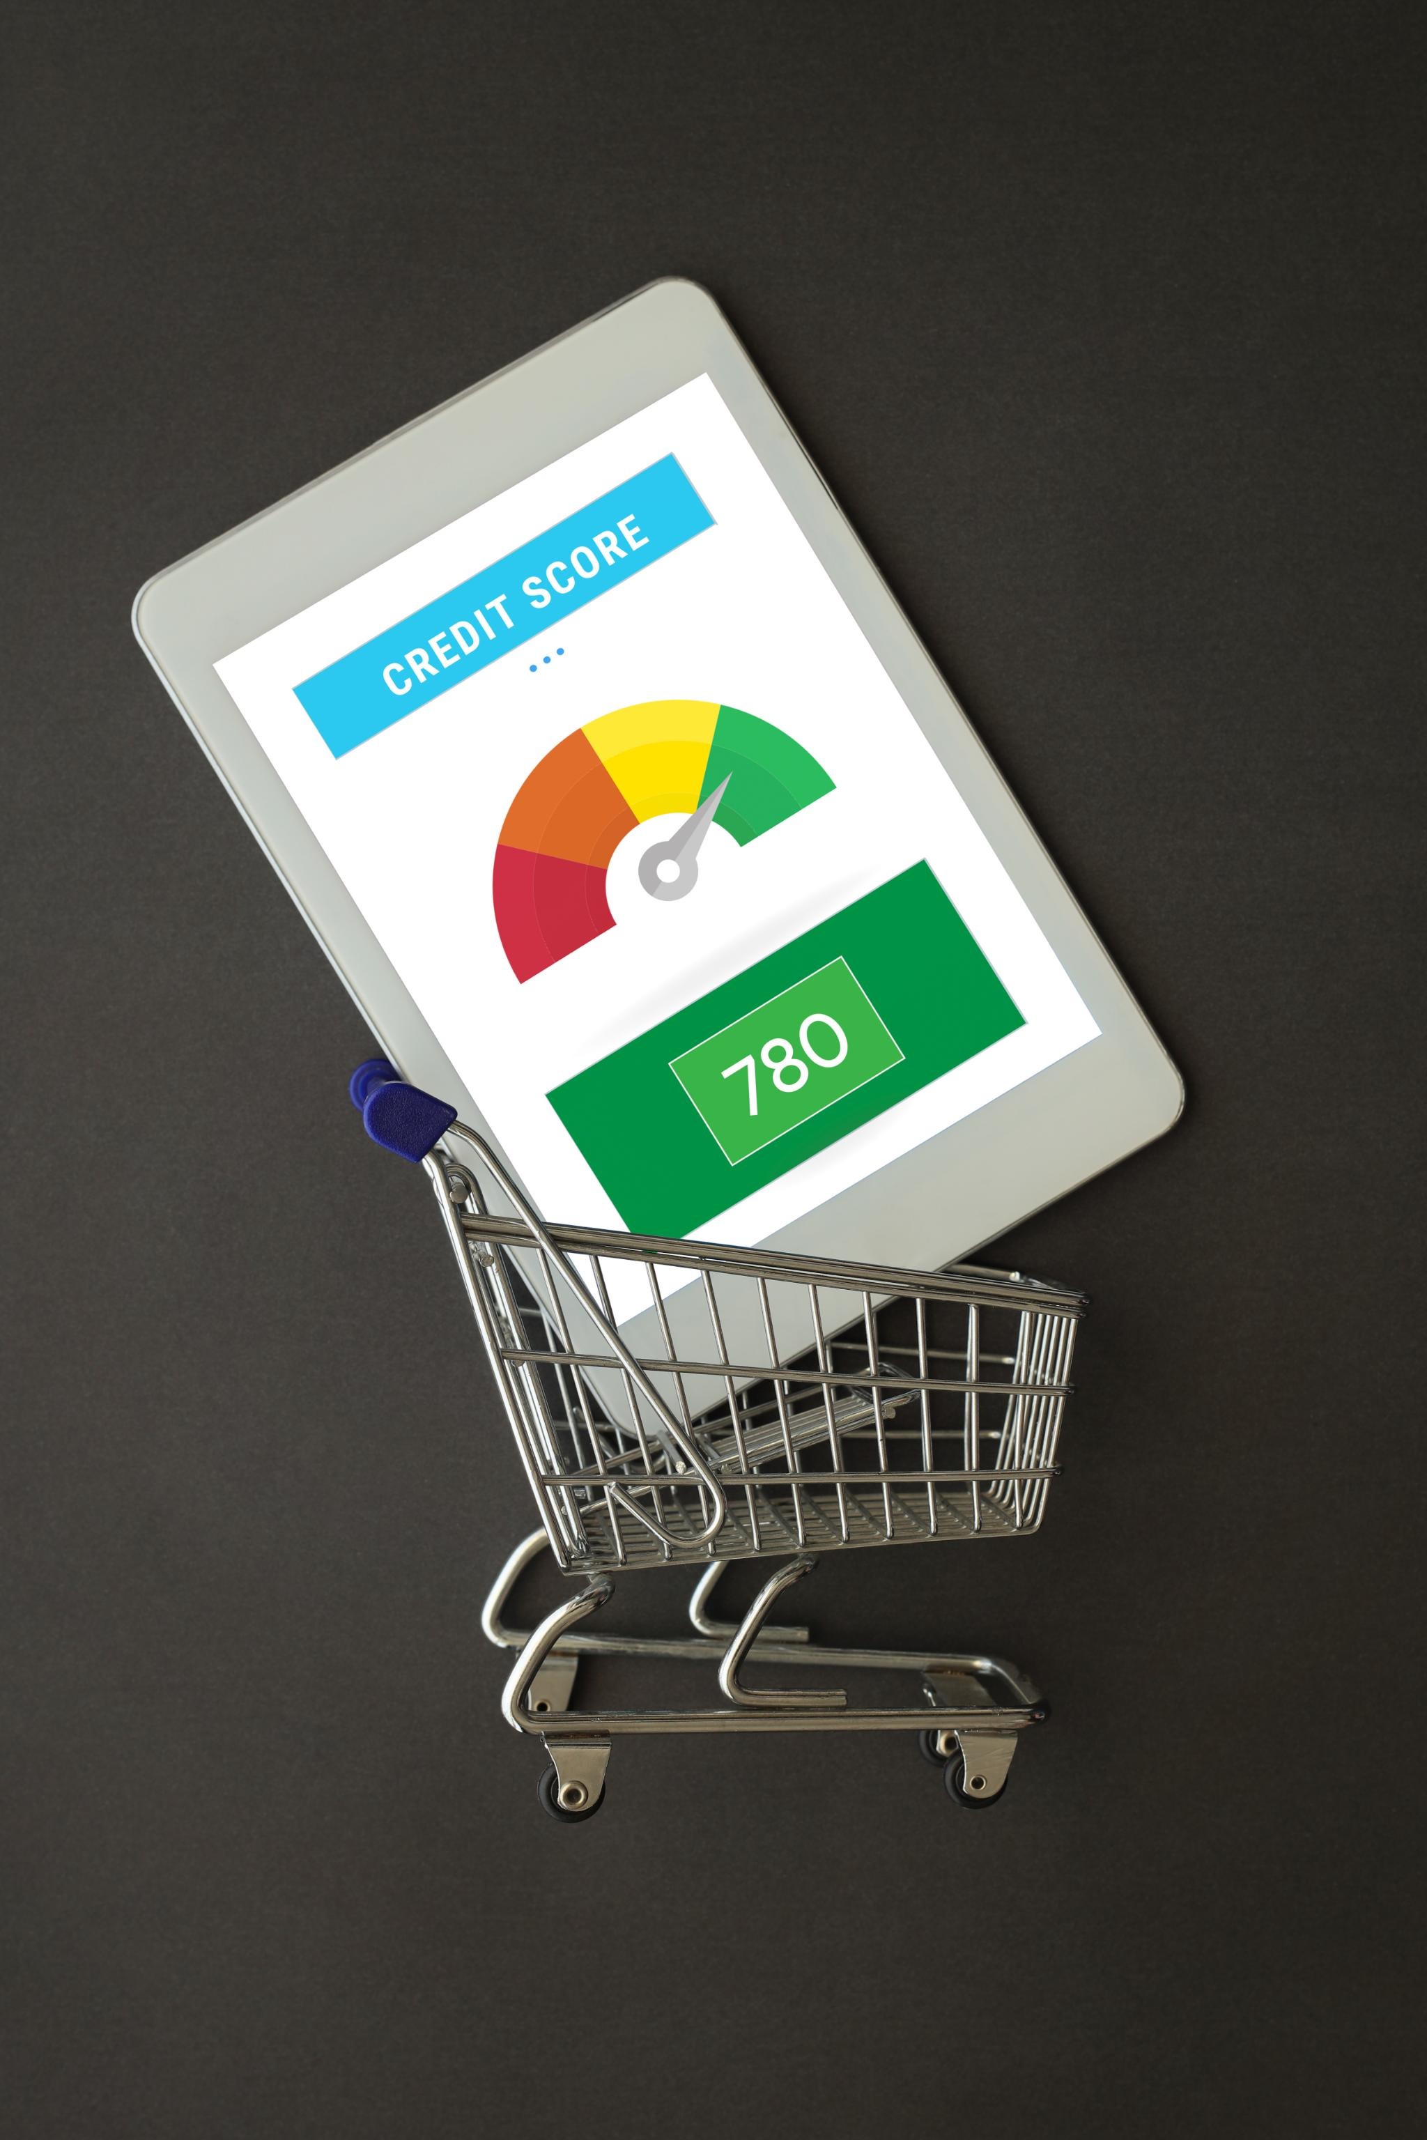
SwiftCart Hub Excel Dashboard Project
Introduction to the SwiftCart Hub Excel Dashboard Project.
Focus on data-driven insights for e-commerce.
Presented by [Your Name] on [Insert Date].
Notes:
This slide introduces the SwiftCart Hub Excel Dashboard Project, highlighting its focus on providing data-driven insights crucial for e-commerce success. It's important to capture the interest of the audience by outlining the relevance of the project in today's digital marketplace.

Slide 2
SwiftCart Hub is a fast-growing e-commerce brand.
Offers a wide range of products with a focus on efficient delivery and high customer satisfaction.
Mission: Seamless shopping & cost-effective delivery.
Vision: To become a leader in data-driven e-commerce operations.

Slide 3
Problem Statement
Lack of centralized analytics made it difficult to:
Track KPIs
Identify trends
Make data-driven decisions
Impact: Revenue loss, customer dissatisfaction, and operational inefficiencies.

Slide 4

Defining Our Project Goals
Enhance overall sales performance metrics and targets.
Streamline shipping processes for faster delivery times.
Gain insights into profitability through data analysis.
Foster customer engagement using data-driven strategies.
Achieve excellence in operations to maximize efficiency.
Notes:
In this slide, we will explore our primary project goals. Each goal plays a crucial role in ensuring the success of the SwiftCart Hub. By improving sales performance, we aim to increase revenue. Enhancing shipping efficiency will lead to higher customer satisfaction. Understanding profitability is essential for sustainable growth, and leveraging data for customer engagement will help us build strong relationships. Finally, operational excellence is necessary to ensure smooth operations.

Slide 5

Key Focus Areas for SwiftCart Hub
Sales objectives include analyzing product trends and discounts.
Shipping focuses on evaluating delivery times by region.
Profitability involves calculating margins and analyzing costs.
Customer segmentation targets high-value groups for better service.
Dashboard design aims to create an interactive user experience.
Notes:
This slide outlines the specific objectives of the SwiftCart Hub project. In sales, we aim to identify top products and track discounts to boost revenue. Shipping efforts will focus on evaluating delivery durations by different regions and modes. Profitability will be assessed by calculating margins and analyzing the cost of goods sold versus revenue. Additionally, we plan to segment customers to better identify high-value groups, while the dashboard design will prioritize user interactivity.

Slide 6
Project Workflow
Step 1: Data Import & Cleaning
Step 2: KPI Definition & Analysis (Formulas, Pivot Tables)
Step 3: Dashboard Development (Charts, Filters, Slicers)

Slide 7
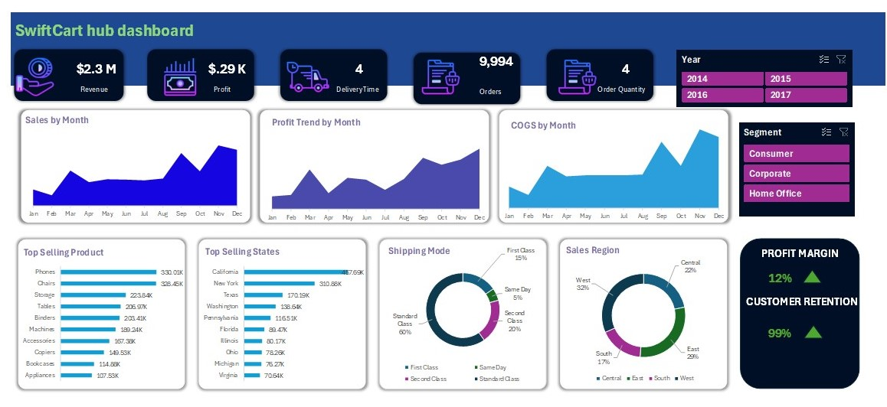

Slide 8
Insights & Findings
Phones and Chairs are top-selling products.
California and New York lead in sales.
Standard Class dominates shipping mode (60%).
West region has the highest sales (32%).
Profit and COGS show clear seasonal trends.

Slide 9

Conclusion & Recommendation
Dashboard supports real-time decision-making.
Clear visibility into performance metrics.
Recommending periodic dashboard updates.
Extend analysis to customer behavior for better marketing.

Slide 10

Thank You

